Slide 1
Color and pattern

Slide 2
What is color??
The reflection of light on and object
Has 3 properties: hue, value, intensity
Based on your experience color will be interpreted differently

Slide 3
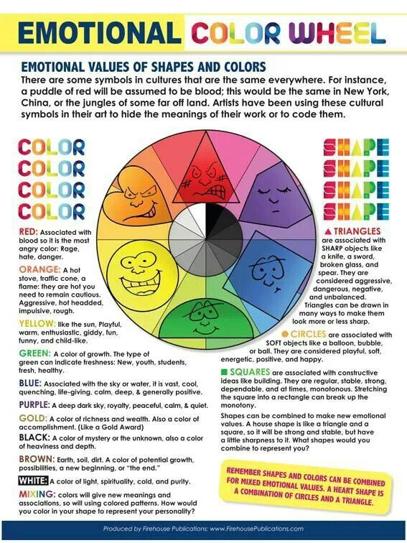

Slide 4
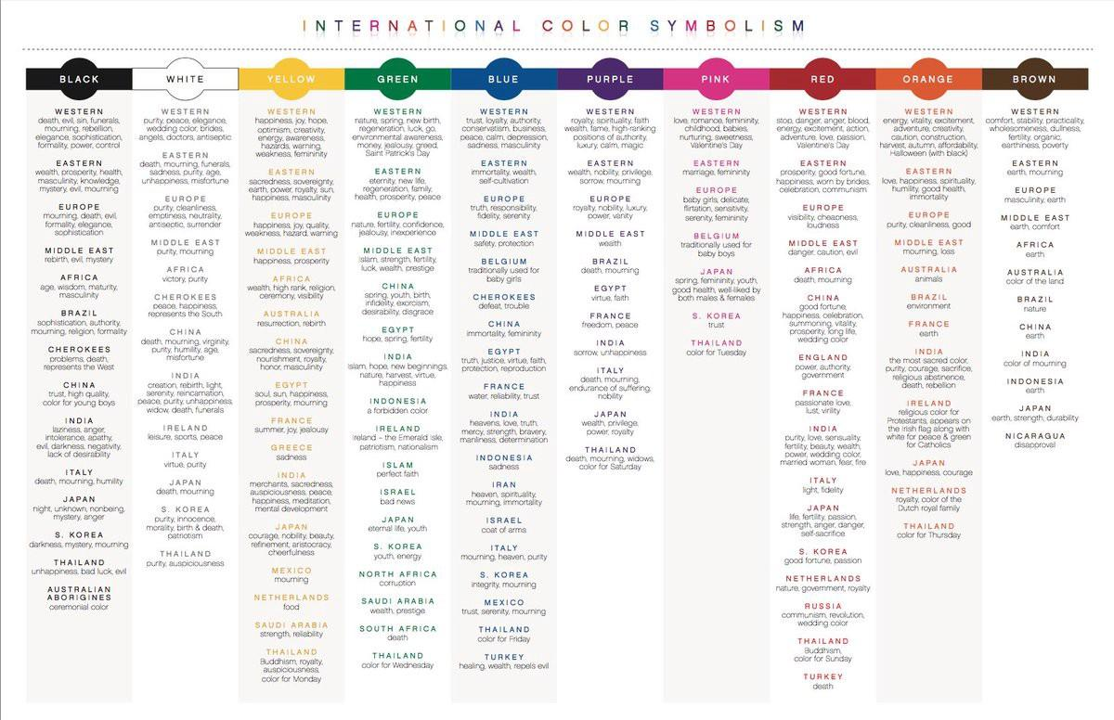

Slide 5
What is Pattern??
An element in art that is repeated over and over again
Repeated lines, repeated shapes, repeated colors

Slide 6
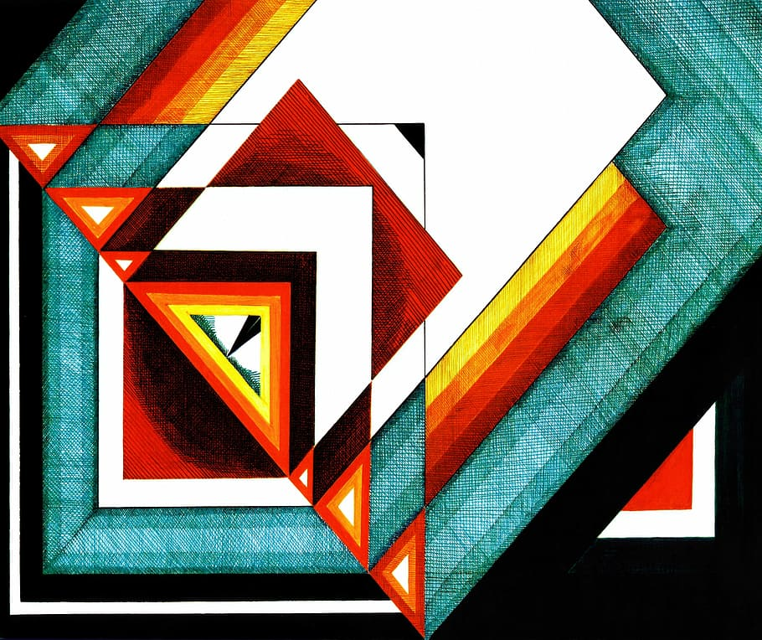
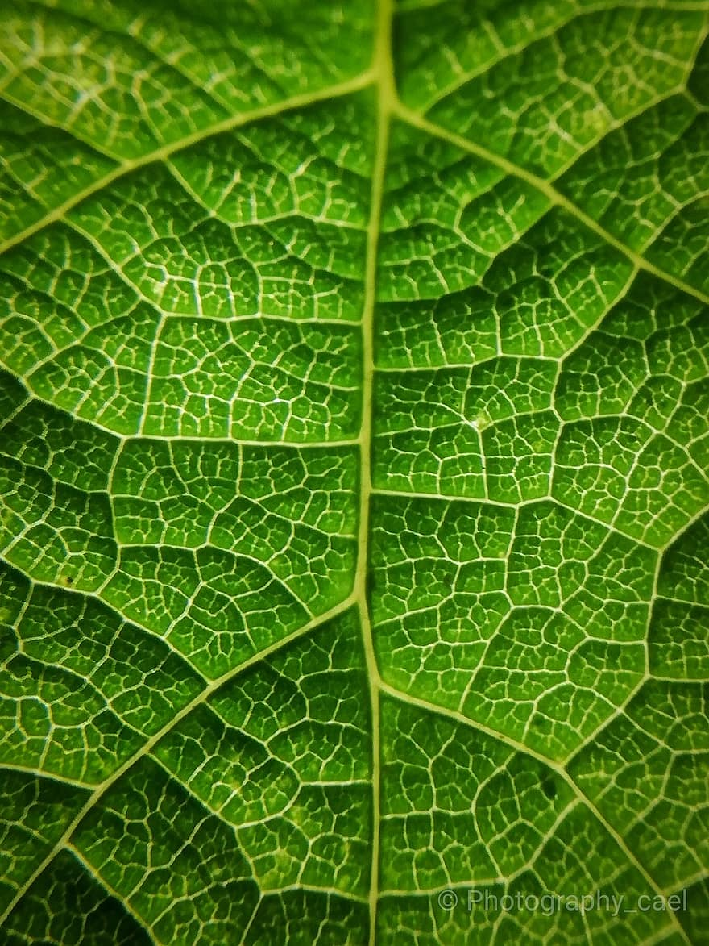

Slide 7
Today’s project
Choose one of the following options to work with:
Water landscape
Desert landscape
Mountain landscape
** Pick a time of day**
Landscape Design

Slide 8
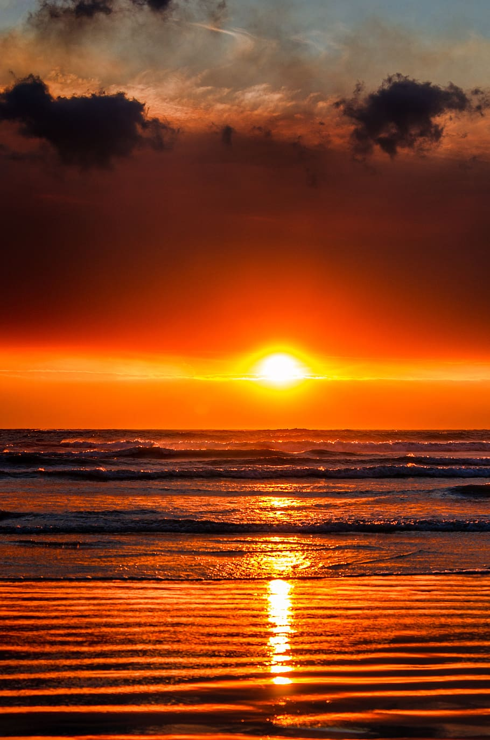
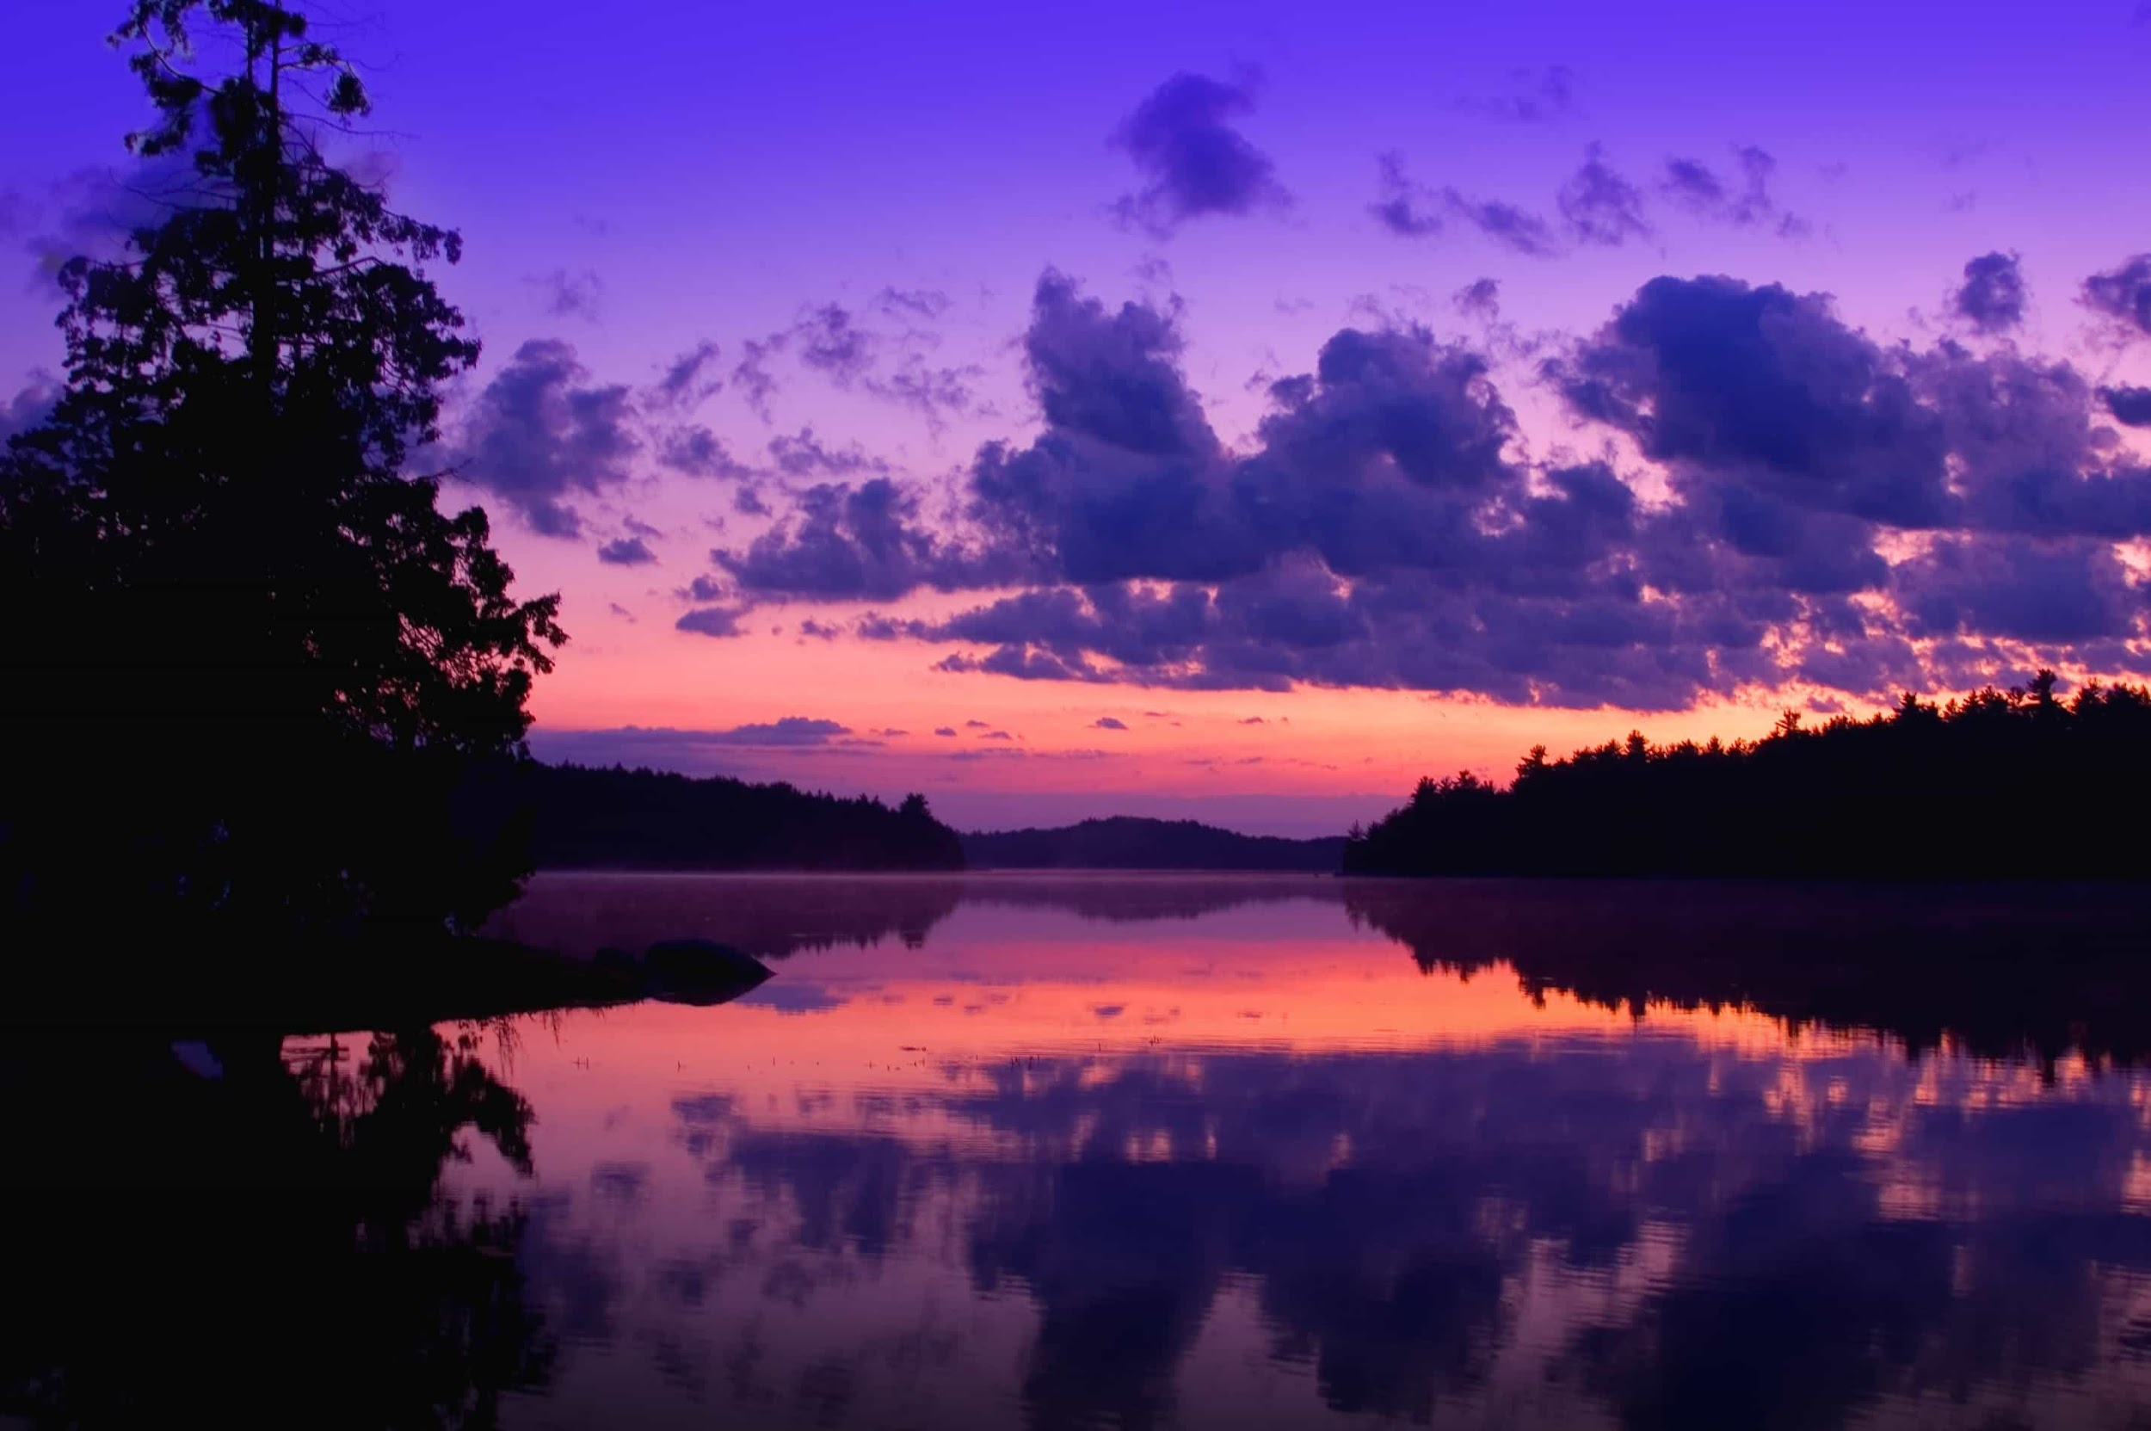
Water Landscapes

Slide 9
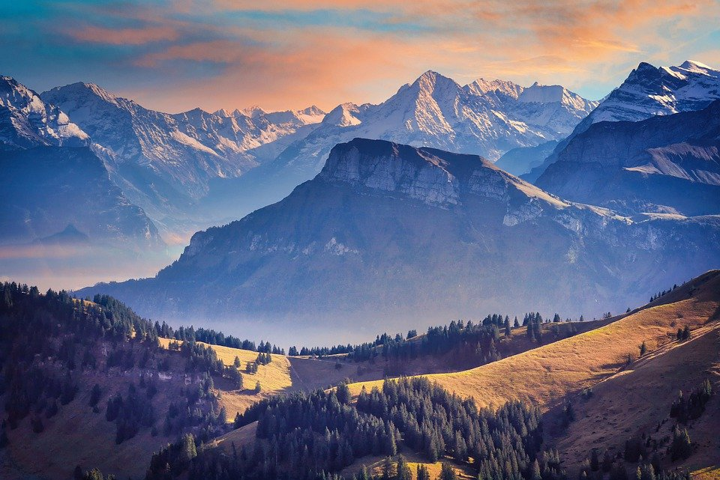
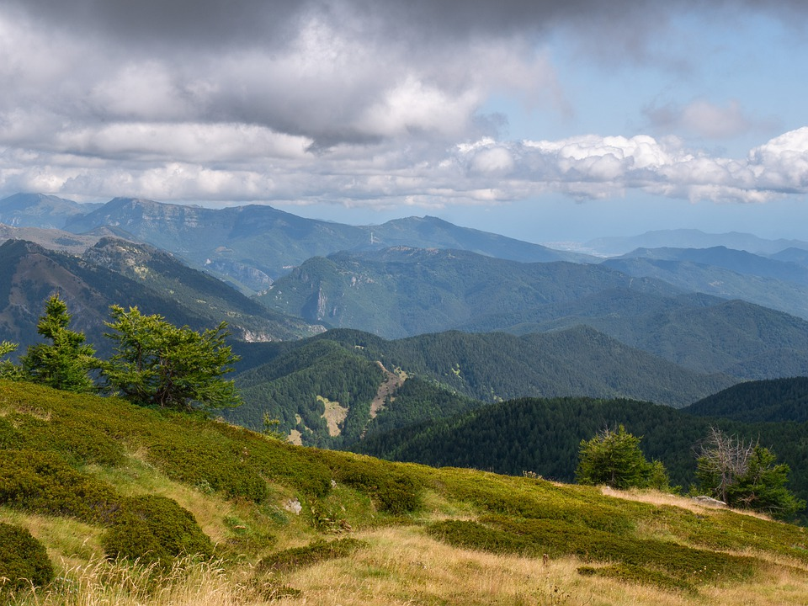
Mountain Landscapes

Slide 10
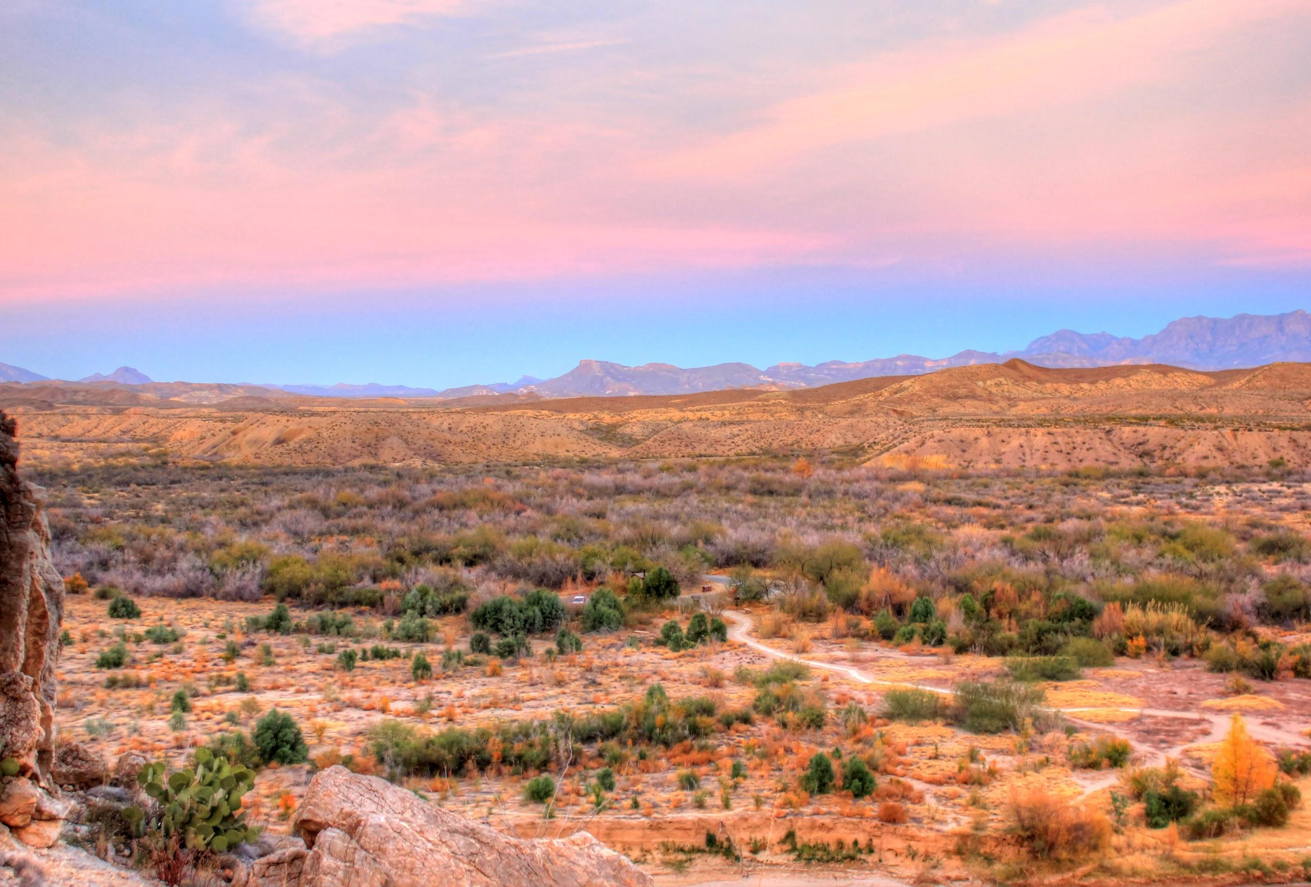
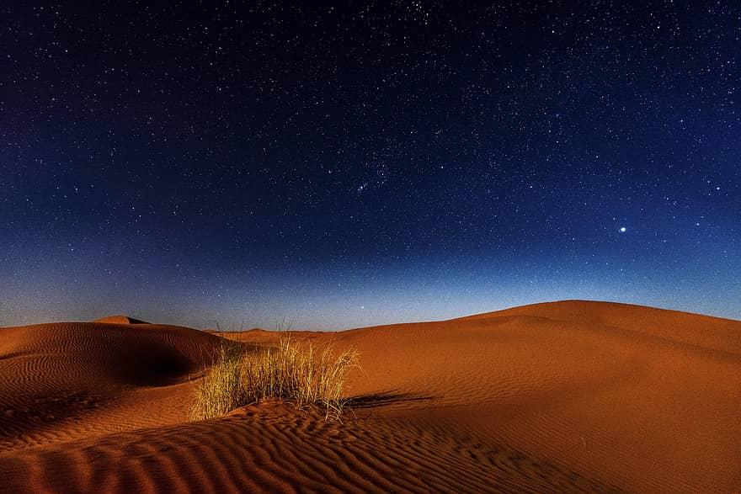
Desert Landscapes

Slide 11
Project: Landscape design
Go to the following link: https://thisissand.com/
Create a “landscape” (water, mountain, desert- think what colors you want to use)
Fill the entire space
Use solid colors and blended /gradient (look at video for tutorial)
Email me a picture: Alexandra.Ogle@bsd.k12.de.us or text to my google number 856-418-0477 and let me know your name.

Slide 12
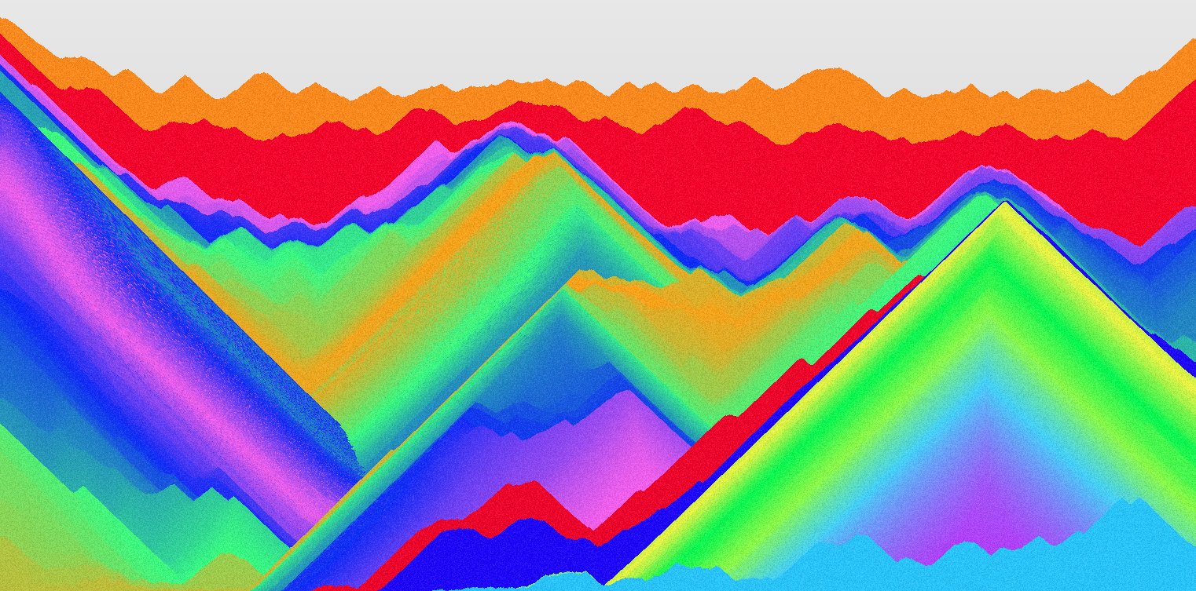
Example 1

Slide 13
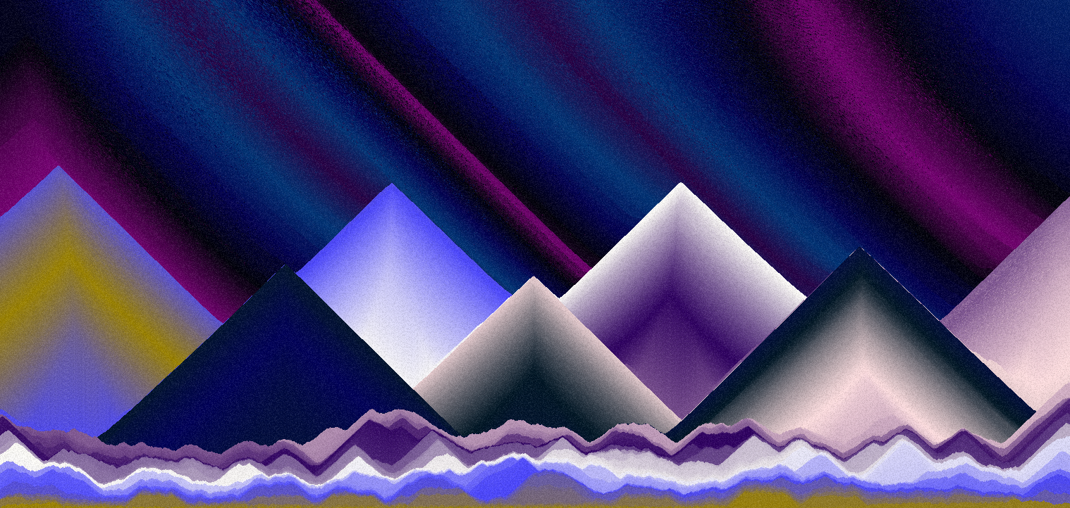
Example 2

Slide 14
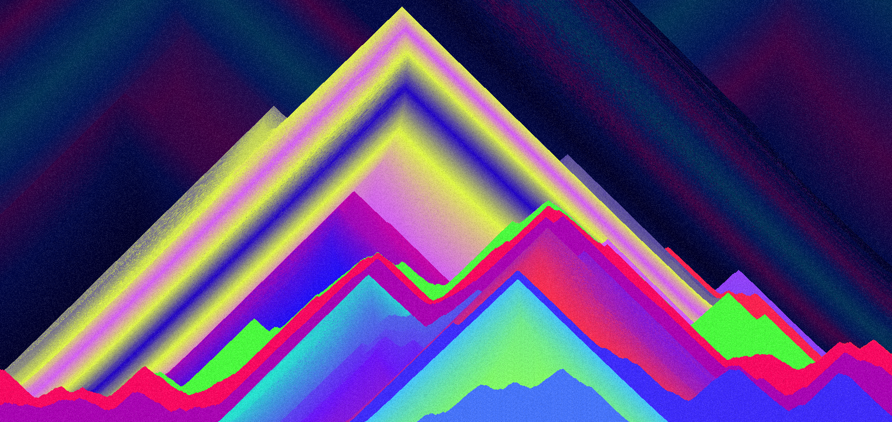
Example 3

Slide 15
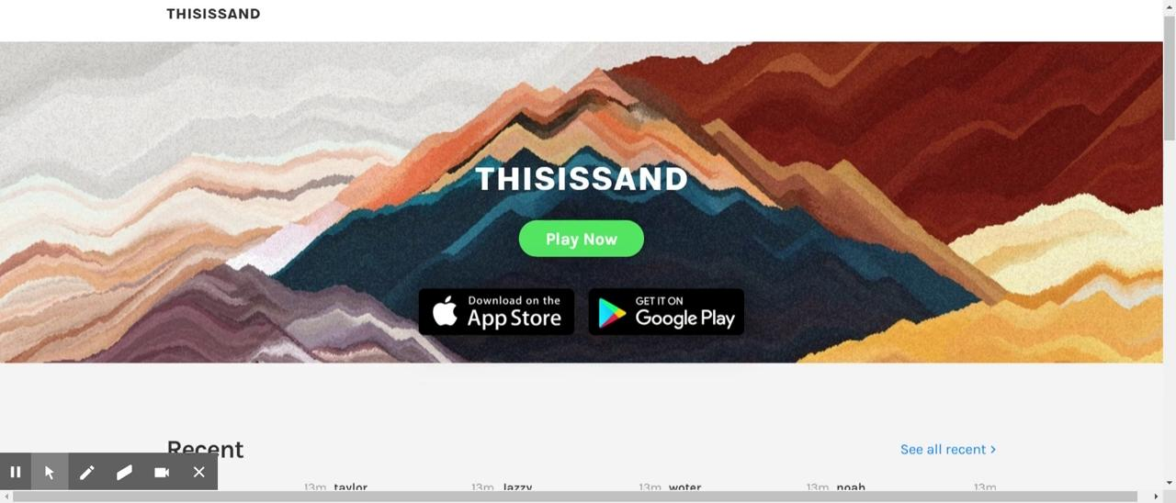
How to use the program- click play to listen

